Slide 1
SQL task
CASE 2
CREATE TABLE STUDENTS

Slide 2
1
-- create a table
CREATE TABLE students ( id INTEGER PRIMARY KEY,
name TEXT NOT NULL,
degree TEXT NOT NULL,
dyear int not null);
-- insert some values
INSERT INTO students VALUES (1, 'Ryan', 'Bcom ','1’);
INSERT INTO students VALUES (2, 'akshay', 'Bcom','3’);
INSERT INTO students VALUES (3, 'abhinav', 'Bcom','6’);
INSERT INTO students VALUES (4, 'sarvesh', 'Bcom','7’);
INSERT INTO students VALUES (5, 'vishaka', 'Bcom','2’);
-- fetch some values
SELECT * FROM students

Slide 3
2
-- create employee table
CREATE TABLE employee (
emp_id INTEGER PRIMARY KEY,
emp_name TEXT NOT NULL,
gender TEXT NOT NULL,
birthday,salary INTEGER not null,
branch_id INTEGER not null,
supervisor_id INTEGER,
foreign key(branch_id) references branch(branch_id),
foreign key(supervisor_id) references employee(emp_id));

Slide 4
2 continue
-- insert employee values
INSERT INTO employee VALUES (101, 'Anand', 'M','2/06/90','5000000','1','null’);
INSERT INTO employee VALUES (102, 'brijesh’,
'M','28/07/90','5000000','1','101’);
INSERT INTO employee VALUES (103, 'chandni', 'F','03/09/92','5000000','1','102’);
INSERT INTO employee VALUES (104, 'dia', 'F','27/09/92','5000000','1','102');INSERT INTO employee VALUES (105, 'faraz', 'M','30/12/96','5000000','1','103’);
-- fetch some values
SELECT * FROM employee;

Slide 5
3
-- create branch table
CREATE TABLE branch (
branch_id INTEGER PRIMARY KEY,
branch_name TEXT not null,
mgr_id INTEGER not null,
foreign key(mgr_id) references employee(emp_id)
);
-- insert branch valus
INSERT INTO branch VALUES (1,'mumbai','101’);
INSERT INTO branch VALUES (2,'delhi','104’);
INSERT INTO branch VALUES (3,'banglore','102’);
-- fetch some values
SELECT * FROM branch;

Slide 6
4
-- create client table
CREATE TABLE client (
client_id INTEGER PRIMARY KEY,
client_name TEXT not null,
branch_id INTEGER not null,
foreign key(branch_id) references employees(emp_id)
);
-- insert branch valus
INSERT INTO client VALUES (401,'p','2’);
INSERT INTO client VALUES (402,'q','2’);
INSERT INTO client VALUES (403,'r','3’);
INSERT INTO client VALUES (404,'s','3’);
-- fetch some values
SELECT * FROM client;

Slide 7
5
-- create supply table
CREATE TABLE supply (
branch_id INTEGER,
sup_name TEXT not null,
supply_type TEXT not null,
primary key(branch_id,sup_name) );
-- insert branch valus
INSERT INTO supply VALUES (1,'ABC','Stationary’);
INSERT INTO supply VALUES (1,'PQR','files’);
INSERT INTO supply VALUES (2,'ABC','stationary’);
INSERT INTO supply VALUES (3,'ABC','stationary’);
INSERT INTO supply VALUES (3,'XYZ','others’);
-- fetch some values
SELECT * FROM supply;

Slide 8
6
-- create sales table
CREATE TABLE sales (
emp_id INTEGER ,
client_id INTEGER not null,
total_sales INTEGER not null,
primary key(emp_id,client_id) );
-- insert branch valus
INSERT INTO sales VALUES (104,'401','5000000’);
INSERT INTO sales VALUES (104,'402','7500000’);
INSERT INTO sales VALUES (102,'403','2500000’);
INSERT INTO sales VALUES (105,'404','1000000’);
-- fetch some values
SELECT * FROM sales;

Slide 9
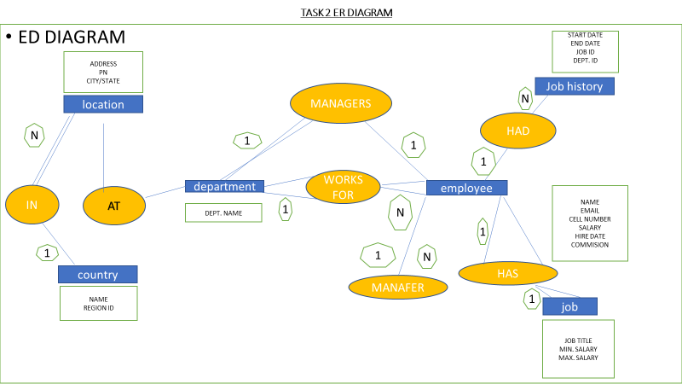
SQL task 2

